Slide 1
Virtual Machines
Dan Tsafrir & Yoav Etsion

Slide 2
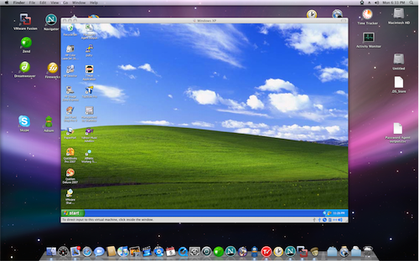
What is virtualization?
Decouple software from hardware in a way that allows running multiple OSes on same hardware
E.g., run both Windows and Linux on same laptop
How is it different than dual boot?
Both OSes run simultaneously
Yet, by default, they are completely isolated from each other
Called: “Virtual machine” (VM)

Slide 3
Benefits
Server consolidation (perhaps the most important, money-wise, and in terms of how it affected the world)
E.g., run
web server “machine”, and
mail server “machine”, and
DHCP server “machine”, …
on the same physical machine
Until virtualization, different servers were often kept on separate machines for robustness
Significant power/cooling savings
Significant room space savings
Utilization of physical machine goes up
Used more effectively
Technology goes back to mainframes…

Slide 4
Benefits
Eases administration and improves robustness
Untying SW from HW makes life easier to, e.g.,
backup server “machines”
restore them if HW break on a different physical machine
upgrading to newer machines
Since HW and SW are decoupled, can perform “live migration”
Moving VM from one physical machine to another while running
Easier provisioning of new server “machines” for new services (one can have a “new” machine ready in seconds)
Easier testing & quality assurance
Products sometimes span multiple machines
E.g., testing a network product (such as a firewall) might require dozens of computers

Slide 5
Benefits
Makes the IaaS cloud computing ecosystem possible
IaaS = Infrastructure as a Service
Cloud providers, like Amazon, sell compute power
You pay for, e.g., 2 cores for 3 hours + 10GB of network traffic
You can install all your software, OS and workloads it supports
Your (virtual) machine is isolated from other (virtual) machines
Similarly (more or less) to physical machines
An IT organization can have a server farm
Remotely (without having to allocate room)
Without hiring staff, handling faulty machines, and all that jazz
The cloud is “elastic”: customers can easily grow and shrink their compute infrastructure as needed
Balance load with live migration

Slide 6
Definitions
Hypervisor or VMM (Virtual Machine Monitor)
The SW layer that allows several virtual machines to run on the same physical machine
Host
The physical machine & OS that directly controls it
Overload term: sometimes we say “host” but really mean hypervisor
Guest (or guest OS)
The virtual machine: its OS and all the applications it runs

Slide 7
Hypervisor Types
Type 1 (“bare-metal”)
Type 2 (“hosted”)
VM1
VM2
Guest
Guest
VM1
VM2
process
hypervisor
hypervisor
OS
Host
Host
hardware
hardware
E.g., VMware ESX, MS Hyper-V, Xen (typically used in servers, datacenters, clouds)
E.g., VMware Workstation, MS Virtual PC, Sun VirtualBox, QEMU (typically, user-owned)

Slide 8
Hypervisor Types
Bare-metal (Type 1)
Has complete control over HW
Doesn’t have to “fight” the bare metal OS, co-exists with it
Hosted (Type 2)
Avoids functionality/code duplication (e.g., process scheduler, memory management) – the OS already does all of that
Familiar environment that is easier to manage
How much CPU and memory does a VM take? – Use ‘top’
How big is the virtual disk? – Use ‘ls –l’
Kill/suspend a VM? Send SIGKILL/SIGSTOP to it

Slide 9
Hypervisor Types
A combination
Much is hosted, but some parts are inside the OS kernel for the reasons listed earlier, plus performance
Example: Linux/KVM + QEMU
KVM ~ transforms the Linux kernel into a hypervisor
Kernel Virtual Machine
QEMU is a process that can operate without KVM
but is accelerated by KVM

Slide 10
How virtualization works
Hypervisor
Like the kernel, manages the physical resources
VMs
Are like processes
Hypervisor
schedules VMs,
allocates memory for them,
multiplexes their I/O, etc.
Just one problem…
OSes think/assume they control bare-metal HW
Solution
Hypervisor must fake it: make it appear as if the guest controls the HW

Slide 11
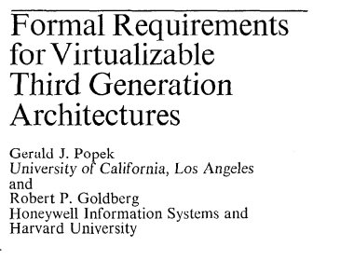
The basic concept: Trap & Emulate
Principles laid out by Popek & Goldberg in their 1974 paper
Guests must not be granted direct access to global system state
Whenever a guests tries to do that, hypervisor assumes control
Hypervisor emulates the guest’s protected functionality
Gerald J. Popek and Robert P. Goldberg. “Formal requirements for virtualizable third generation architectures”. Commun. ACM 17, 7. July 1974.

Slide 12
Trap & Emulate
Most VM code can execute directly on CPU just fine
E.g., addl %ebx, %eax – if VM1 does this, VM2 doesn’t care
Let such code run directly on CPU
Hypervisor must take over protected operations, e.g.,
int $0x80 // generate system call interrupt Hypervisor knows that from now on the guest thinks it’s in privileged mode; guest can’t really run in privileged mode, of course, because otherwise it’d be able to mess stuff up for the host & other guests
movel <address>, %cr3 // switch page tables Hypervisor can’t allow the guest to manipulate address spaces on its own, but it can do it for the guest
I/O ops // hypervisor can’t allow VMs to directly access I/O (I/O channels are multiplexed by the host to allow all the guests to use them; also, I/O devices handling will not be able to tolerate multiple OSes performing uncoordinated ops)

Slide 13
Implementing Trap & Emulate
A few techniques
Software emulation
Dynamic binary translation
Paravirtualization
Hardware support
Need to virtualize
CPU
memory
I/O
Let us first focus on the CPU…

Slide 14
SW emulation
Do what CPU does, but in software
Fetch the next instruction
Decode (is it an ADD? XOR? MOV?)
Execute (using the SW emulated registers and memory)
Example:
addl %ebx, %eax /* eax += ebx */
Is emulated as
enum {EAX=0, EBX=1, ECX=2, EDX=3, …}; unsigned long regs[8]; regs[EAX] += regs[EBX];
Pro: Simple, flexible (can run Arch1 code on Arch2) Con: Slow
Example: BOCHS

Slide 15
Dynamic binary translation
Translation rules
Most code translates to something that does exactly the same
E.g., movl %eax, %ebx
Sensitive ops are translated into explicit “hypercalls”
= Calls into hypervisor
(to ask for service)
Implemented as trapping ops
(unlike, e.g., POPF)
Similar to syscall
(call into hypervisor to request service)

Slide 16
Dynamic binary translation
Solution #2: dynamic binary translation – idea
Block of (VM) ops encountered for 1st time?
Translate block, on-the-fly, to “safe” code
Similarly to JIT-ing (JIT compilation = just-in-time compilation)
Put block in “code cache” (indexed by address)
From now on when program reaches this address
Safe code would be executed directly on CPU
BTW
You can easily do above, on your own, for your user-level apps
Download Intel’s pin
http://software.intel.com/en-us/articles/pin-a-dynamic-binary-instrumentation-tool

Slide 17
Dynamic binary translation
Pros
No hardware support required
Performance is much better than full SW emulation
Cons
Harder (!) to implement
Hypervisor needs on-the-fly x86-to-x86 binary compiler
Consider the challenge of getting branch target addresses right
Performance may not be as good as HW-supported trap-and-emulate
Example hypervisors
VMWare (x86 32bit), QEMU (which may run, say, POWER on x86)

Slide 18
Paravirtualization
In paravirtualization, guest “knows” it is being virtualized
OS programmer explicitly uses hypervisor services through a hypercall
E.g., instead of doing “cli” to turn off interrupts, guest OS should do: hypercall( DISABLE_INTERRUPTS )
Pros
No hardware support required
Cons
Requires specifically modified guest
(Every guest OS should be modified)
Example hypervisor
Xen (in the past)

Slide 19
Hardware Support
Sensitive instructions generate a trap when executed by guest
E.g., if guest runs INT $0x80, trap it and execute guest’s handler of interrupt 0x80
We are leveraging the fact that many sensitive operations trigger an interrupt when performed by unprivileged user-mode SW
Pro
Performance (over SW emulation)
Cons:
All sensitive instructions must be tagged at design time
For some instruction, hypervisor may decide not to trap
Hardware bugs are hard to fix…

Slide 20
Hardware Support
Intel calls such support “VMX”
AMD calls such support “SVM”
ARM’s AArch64
Example hypervisor
As opposed to earlier hypervisors, Linux KVM was originally implemented by making use of HW support for virtualization
Hypervisors that predate HW support used different methods

Slide 21
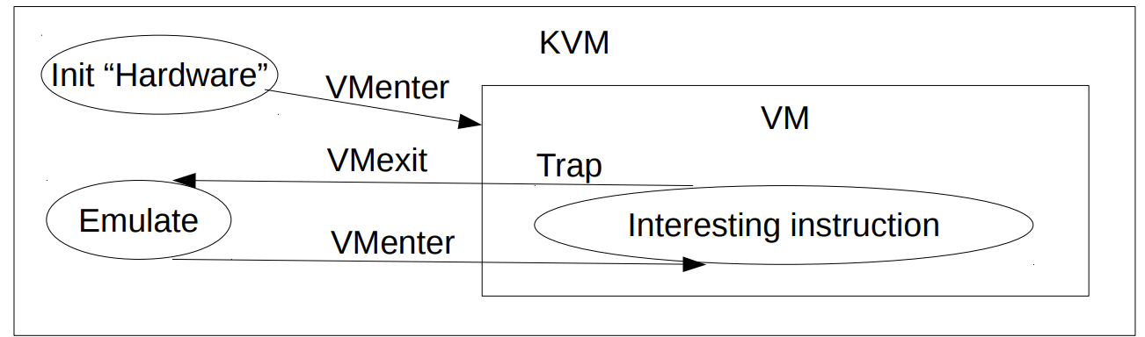
Hardware support
Hardware-based trap and emulate still has overheads
vmexit: Leave running VM and switch to hypervisor/VMM
vmenter: Resume execution of VM
These operations still incur thousands of cycles of overhead
1K-4K on modern Intel AMD
A real challenge in systems with frequent syscalls/IO/Nested VMs

Slide 22
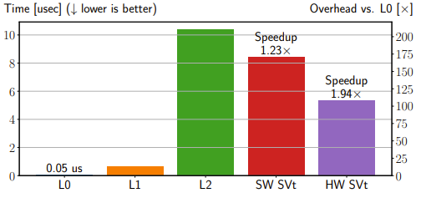

vmenter/vmexit
These basic overheads are fundamental problem
Example: calling the cpuid inst.
L0: hypervisor/native
L1(VM): ~10x slower
L2(nested VM): >200x slower
Overheads get even worse with nested virtualization
Why?
Overhead [x]
Vilanova et al., “Using SMT to Accelerate Nested Virtualization”. In ISCA 2019

Slide 23
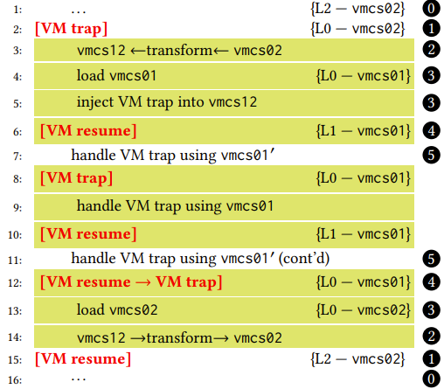
Nested virtualization
When you get a VM from AWS, why not run a VM inside it?
Manage you own mini-cloud
Compatibility with old hardware
vmexit/vmenter are a real pain
Every vmexit have to go all the way to the main hypervisor (L0)
Avoiding vmexit is an active research area
Vilanova et al., “Using SMT to Accelerate Nested Virtualization”. In ISCA 2019

Slide 24
Mitigating the overheads of vmexit
Avoid context switching the same thread
SMT gives us another thread in the same core
As it happens, SMT is often not used because of security concerns
Why not run the main (L0) hypervisor on another SMT thread?
Vilanova et al., “Using SMT to Accelerate Nested Virtualization”. In ISCA 2019

Slide 25
Prevailing trend
Trap & emulate with HW support (VMX, SVM, …)
Paravirtualization for I/O devices
To simply things
To bridge the “semantic gap”
Let the hypervisor know what’s going on inside the VM)

Slide 26
How to run a VM?
The problem
OSes think/assume they control bare-metal HW
The solution
Hypervisor must lie to the guest and fake it: make it appear as though the guest controls the HW
How? A few alternatives
Emulation
Trap-and-emulate
Dynamic binary translation
Paravirtualization
Need to virtualize: (1) CPU; (2) memory; (3) I/O
Let us first focus on the CPU…
Recall that so far we’ve focused on the CPU
We’ll discuss memory in a separate class

Slide 27
Reminder: x86 paging
Need to translate
from: virtual addresses
to: physical addresses
Translation is cached on-chip TLB
(Translation Lookaside Buffer)
Page table is read & modified by HW
(Access/dirty bit)
Each process has its own virtual address space
Page table pointed to by CR3 register
During context switch the OS updates the value of CR3.
Page table is a hierarchical structure

Slide 28
Reminder: x86 paging
Linear Address Space (4K Page)
63
47
39
38
30
29
21
20
12
11
0
sign ext.
PML4
PDP
DIR
TABLE
OFFSET
9
9
9
9
12
4KByte Page
data
512 entry Page Directory
Pointer Table
512 entry
Page Directory
512 entry Page Table
512 entry PML4 Table
PTE
28
PDE
PDP entry
31
PML4 entry
31
31
40 (4KB aligned)
CR3

Slide 29
Virtualizing the virtual memory
So we previously had to translate
from: virtual addresses
to: physical addresses
But the above is actually
from: guest virtual addresses (GVA)
to: guest physical addresses (GPA)
Both GVA & GPA aren’t real
Do not correspond to the physical memory
Virtualization therefore requires another level of translation
from: guest physical (GPA)
to: host physical (HPA)

Slide 30
Virtualizing the virtual memory
There are two ways to accomplish this additional level
With HW support (called EPT or NPT; E=extended; N=nested)
With “shadow page table”
Which requires no HW support

Slide 31
Shadow page table
Hypervisor computes/builds GVA to HPA translations on the fly, in response to page faults
Storing them in a new set of page tables called shadow page tables
Used by hypervisor instead of guest’s inner page tables
To build/maintain shadow page table
Hypervisor traps-and-emulates all changes made by the guest to its page tables by write-protecting them
All page faults are trapped (hypervisor handles interrupts)
Hypervisor walks the original guest page table
If it’s a “guest page fault” (=no translation in guest page table): “inject” (=emulate) page fault to guest
Otherwise, we found a guest page table translation => Build missing entries in shadow page table using hypervisor’s internal SW data structure that maps guest’s GPA to HPA

Slide 32
Shadow page table
Challenges
Complex… e.g.,
Hypervisor must maintain access/dirty bits within guest PTEs
Hypervisor needs to support all x86 paging modes
real mode, 32bit, 36bit (“PAE”), and 64bit
(modes have different hierarchies, PTE sizes, and huge page sizes)

Slide 33
Shadow page table
To simplify, can start building shadow page from scratch on every cr3 change (= every context switch)
Caching is challenging because, e.g., the guest may start using the pages for other purposes (recall that they are write-protected)
Pro
As noted, requires no HW support
Cons
Complex
Can be slow due to all the overheads involved

Slide 34
2D/nested/extended page table (EPT/NPT)
Since shadow page tables are complex and expensive
=> HW support for 2nd translation table
Processor support two level page tables:
Regular guest page table (GVA => GPA) maintained by guest OS
New second translation table (EPT) from guest physical address (GPA) to host physical address (HPA) maintained hypervisor
Schematically, translations looks as follows
In reality a bit more complex…

Slide 35
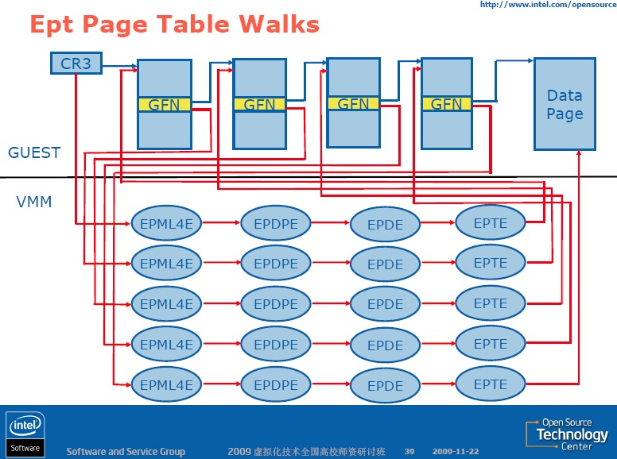
how many mem refs upon TLB miss?
Notes:
GFN = guest frame number

Slide 36
Shadow PT vs. EPT
Tradeoffs discussed to far
EPT requires HW support but
It makes things much simpler relative to shadow PT
And it eliminates much of the shadow PT overheads
Question
Is it possible that using shadow PT will yield performance superior to EPT?
Answer
Yes! (Think of why)

Slide 37
2D/nested/extended page table (EPT/NPT)
Guest has full control over its page table
No need to trap changes in CR3, page faults, modification to guest PTs
EPT’s structure is similar to the x86 page table structure
One issue originally missing and later rectified: updates of access/dirty bits
EPT translation are cached on-chip
Similarly to TLB; eliminates the need to walk the table in the common case
Note that
The EPT table changes less frequently than guest PTs
Interrupts to hypervisor
EPT violation – no translation for the guest physical address
How can we utilize such violations?
EPT misconfiguration

Slide 38
How to run a VM?
The problem
OSes think/assume they control bare-metal HW
The solution
Hypervisor must lie to the guest and fake it: make it appear as though the guest controls the HW
How? A few alternatives
Emulation
Trap-and-emulate
Dynamic binary translation
Paravirtualization
Need to virtualize: (1) CPU; (2) memory; (3) I/O
Let us first focus on the CPU…
Let’s focus on I/O

Slide 39
I/O virtualization
Types of I/O
Block (e.g., HDD, SSD, NVMe)
Network (NIC = network interface card)
Accelerator (e.g., GPU, TPU)
Input (e.g., keyboard, mouse)
Sound
Video
Often performance-critical to servers
Network
Block

Slide 40
Pseudo code of a physical NIC driver (simplified)
Transmit path:
OS prepares packet to transmit in a buffer in memory
Driver writes start address of buffer to register X of the NIC
Driver writes length of buffer to register Y
Driver writes ‘1’ (GO!) into control register T
NIC reads packet from memory addresses [X,X+Y) and sends it on the wire
NIC sends interrupt to host (TX=transmit complete, can free buffer)
Receive path:
Driver prepares buffer to receive packet into
Driver writes start address of buffer to register X
Driver writes length of buffer to register Y
Driver writes ‘1’ (READY-TO-RECEIVE) into control register R
When packet arrives, NIC copies it into memory at [X,X+Y)
NIC interrupts host (RX=receive complete)
OS processes packet (e.g., wake the waiting process up)

Slide 41
Device emulation
Exception!
Guest
VM1
VM2
hypervisor
“device”
Host
hardware
Device

Slide 42
I/O virtualization – emulation
Emulation
Emulate some physical NIC in SW (all hypervisors emulate Intel e1000, all guests have an e1000 driver)
NIC’s emulated registers are mapped to Hypervisor’s memory
Mapped memory is R/W protected, so every register access generates a trap (so hypervisor can react like the NIC) Interrupts are injected by hypervisor to guest
Pros
Unmodified guests (all OSes already have a driver for e1000)
Use only one device => robust
Portable across HW & hypervisors (and hence clouds)
Cons
Slow (traps on every register access)
Hypervisor needs to emulate overly complex HW that wasn’t designed with virtualization in mind (can be much simpler)
Real NIC may provide optimizations (e.g., IP offload)

Slide 43
I/O virtualization – paravirtualization
Paravirtualization
Emulate a “new” device, which isn’t physical in any sense
Guest installs a host-specific device driver
Denoted: paravirtual device driver
Protocol between frontend (driver installed in guest) and backend (hypervisor) is optimized for efficiency
Higher abstraction levels (e.g., IP packets vs. Ethernet frame)
Protocol in emulation case
Guest writes registers X, Y, then writes to register T
=> Hypervisor infers guest wants to transmit packet
Protocol in paravirtual case
Guest does a hypercall, passes it start address and length as arguments; hypervisor knows what it should do

Slide 44
Device paravirtualization
Guest
VM1
VM2
hypervisor
“device”
Host
hardware
Device

Slide 45
I/O virtualization – paravirtualization
Pros & cons
Exactly like emulation, except that it is faster ☺
Requires guest modification, making it less portable ☹
Harder to move between cloud providers
(Every SW modification is a “risk”)
Still not as fast as using the actual HW
Because it’s a SW indirection layer
Difference between paravirtual I/O and paravirtual Guest?
Guest requires to modify whole OS (try do that to windows…)
I/O requires an addition of a single driver (much easier)

Slide 46
I/O virtualization – direct assignment
Direct device assignment
Pull NIC out of host and plug it into the guest for its exclusive use
Guest accesses device directly without hypervisor intervention

Slide 47
Device emulation
Guest
VM1
VM2
hypervisor
Host
hardware
Dev1
Dev1

Slide 48
I/O virtualization – direct assignment
Direct device assignment
Pull NIC out of host and plug it into the guest for its exclusive use
Guest accesses device directly without hypervisor intervention
Pro
Much more performant than paravirtual I/O (which still induces many context switches)
Cons
Need to put many devices in host (one per guest)
And another one for the host
Can’t do I/O interposition
E.g., Monitor traffic, rate-limit VMs
Can’t let VMs directly manage DMA buffers

Slide 49
I/O virtualization – HW support
IOMMU (I/O memory management unit)
I/O devices (like our NIC) perform DMA ops
Access memory on their own
Traditionally, devices used physical addresses to do so
This is seriously problematic in a setup where multiple untrusted guests are simultaneously running, sharing the same machine
What if a guest is malicious or buggy?
(Also, what if device is legacy and can use only 32bit addresses, yet the physical memory is much bigger)

Slide 50
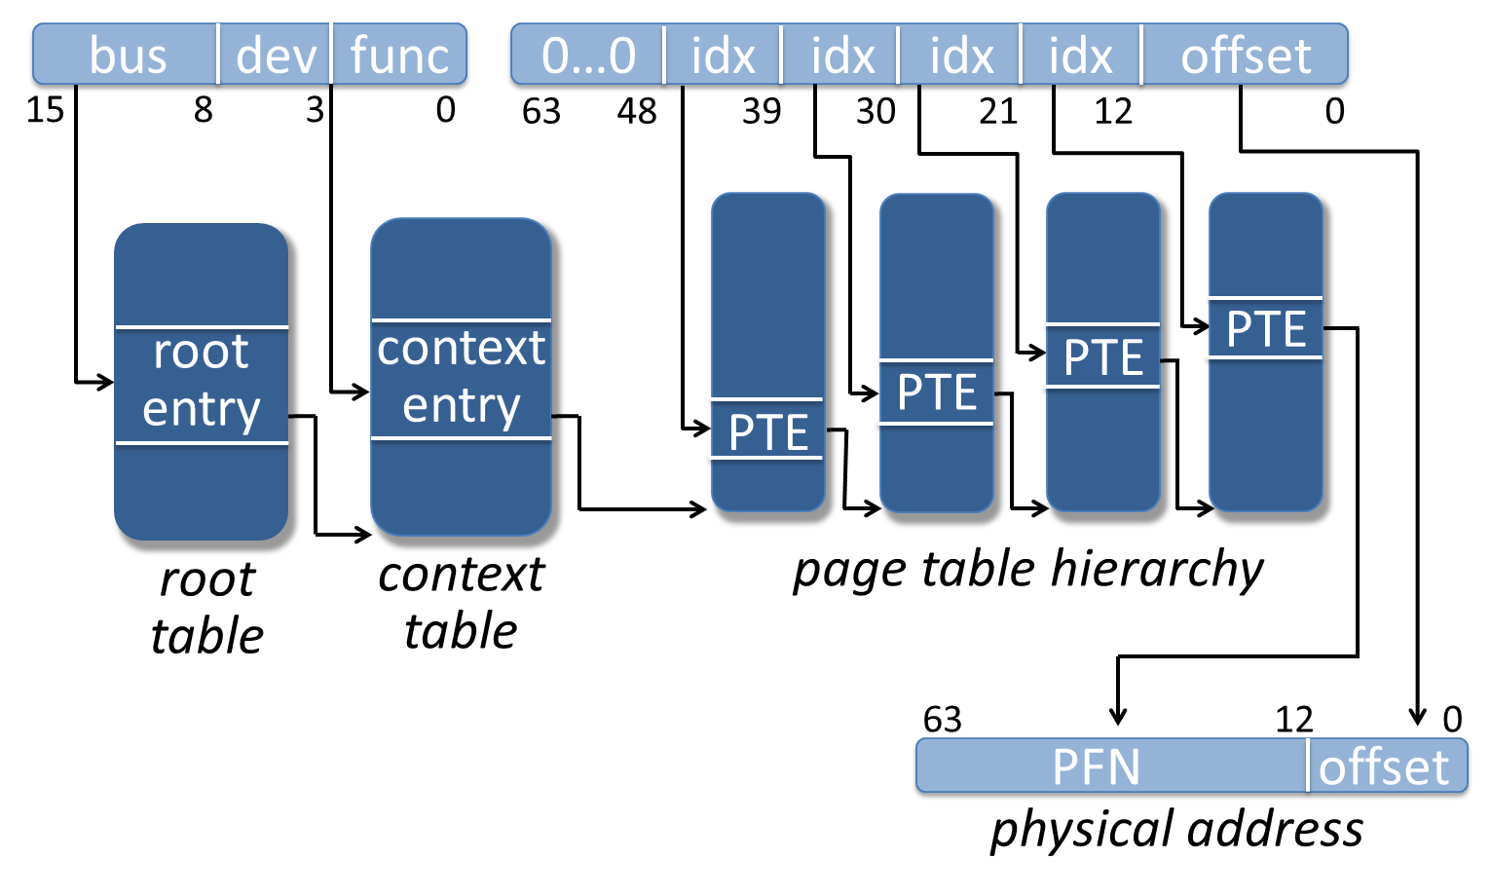
IOMMU translation

Slide 51
I/O virtualization – HW support
IOMMU (I/O memory management unit)
Allows hypervisor to arrange things such that devices use IOVAs (I/O virtual addresses) instead of PAs for their DMA ops
Like the MMU, the IOMMU knows how to walk the table
Has an IOTLB to cache recent mappings (like the MMU’s TLB)
Page faults are a problem
If a page is not mapped, IOMMU must interrupt hypervisor
What do we do with incoming traffic while hypervisor maps a page?
Nested IOMMU page walk were subsequently added

Slide 52
I/O virtualization – HW support
SRIOV
The ability of a device to appear to SW as multiple devices
Single root I/O virtualization
Contains a physical function controlled by the host, used to create virtual functions
Each virtual function is assigned to a guest (like in direct assignment)
Each guest thinks it has full control of NIC, accesses registers directly
Device does multiplexing/demultiplexing of traffic

Slide 53
Device emulation
Guest
VM1
VM2
hypervisor
Host
hardware
Dev
Dev
Dev

Slide 54
I/O virtualization – HW support
SRIOV
The ability of a device to appear to SW as multiple devices
Single root I/O virtualization
Contains a physical function controlled by the host, used to create virtual functions
Each virtual function is assigned to a guest (like in direct assignment)
Each guest thinks it has full control of NIC, accesses registers directly
Device does multiplexing/demultiplexing of traffic
Pro:
Nearly fast as device assignment
And need only one NIC (as opposed to direct assignment)
Cons
Passes virtualization complexity to device
I/O interposition must be supported at the device level

Slide 55
x86 Virtualization Performance
bare-metal performance
☺
CPU intensive
😐
VM performance
memory
I/O intensive
☹
HW supports
CPU virt
HW supports
MMU virt
HW supports
I/O virt
Exitless Interrupts (ELI)
HW support for virtualization
Amit et al., “Bare-metal performance for virtual machines with exitless interrupts”. In Comm. ACM, Jan 2016

Slide 56
Containers
In many cases, the guest OS is the same as the host OS
Typically Linux
Can we get rid of the guest VM altogether?
VM1
VM2
Guest
process
hypervisor
OS
Host
hardware

Slide 57
Containers
If we just get rid of the guest, we get individual processes
VM1
VM2
Guest
process
hypervisor
OS
Host
hardware

Slide 58
Containers
If we just get rid of the guest, we get individual processes
process
P1
P2
OS
hardware

Slide 59
Containers
If we just get rid of the guest, we get individual processes
But to mimic VMs, we want wrap multiple processes in a VM-like container
And manage the container’s resources
Container1
Container2
P1.1
P1.2
P1.3
P1.1
P1.2
P1.3
process
P1
P2
process
OS
OS
hardware
hardware

Slide 60
Containers
If we just get rid of the guest, we get individual processes
But to mimic VMs, we want wrap multiple processes in a VM-like container
Each container sees its own world:
Processes
Network
Filesystem (chroot for many proceses)
We can limit container’s resources:
Memory
Disk space
Memory usage
Network bandwidth
…
Container1
Container2
P1.1
P1.2
P1.3
P1.1
P1.2
P1.3
process
OS
hardware

Slide 61
Containers
Need OS support to manage groups of processes
Main mechanisms:
Namespaces:
A container has a namespace
Resources are assigned to a namespace
Each resource has internal and external names
Processes only see what’s in their namespace
cgroups: Control groups
Control a namespace’s resources
Total amount of memory, network BW, disk space, etc.
Layered filesystem
Each container can see its own disk replica of a common image
Container1
Container2
P1.1
P1.2
P1.3
P1.1
P1.2
P1.3
process
OS
hardware

Slide 62
Containers: Layered/Union filesystem
Each container starts with a base disk image
In reality, the base image is composed of multiple layers of images
Since the disk image is used by many containers, it’s RO
But the container should be able to write files
Base disk image

Slide 63
Containers: Layered/Union filesystem
Each container starts with a base disk image
In reality, the base image comprises of layers of images
Since the disk image is used by many containers, it’s RO
But the container should be able to write files
So, we add a writable layer
Writable layer
Base disk image

Slide 64
Containers: Layered/Union filesystem
Each container starts with a base disk image
Since the disk image is used by many containers, it’s RO
But the container should be able to write files
So, we add a writable layer
Data is only written to the writable layer
Data is read from the most up-to-date layer
In practice, each layer is split into more layers so save space
RD
WR
Writable layer
Base disk image

Slide 65
Containers: Summary
Useful when user needs the same OS in the guest and host
A very common use case
Avoid some of the overheads of virtualization
Faster startup: No need to boot a VM
Faster execution: No vmexit/vmenter on protected instructions
Allow control over a machine-line abstraction
Resource limits, disk view, network
These still incurs some overheads
Open infrastructure to manage images and fleets of containers
Images: Docker, containerd; Fleets: Kubernetes
We only scratched the surface, especially about HW/SW disparity

Slide 66
Thank you ☺
Questions?

